Slide 1
Capstone Project: Drive Your Way

Slide 2

Design and develop an online car selling and buying portal

Slide 3
Problem Statement and Motivation
Problem Statement:
In this project, you should be able to design and develop an online car selling and buying portal.

Slide 4
Problem Statement and Motivation
Real-World Scenario:
Drive Your Way Ltd. is a company working in the business of selling and buying old cars. However, due to the pandemic and lockdown, their business took a hit. They were not able to achieve the decided targets. So, they have decided to go online to increase their revenue.

Slide 5
Deliverables
Features of the application:
Home page
Login page
Register page
Subscription plans and a pricing page
Car categories page
Shortlisted products page
Admin page
Adding filters in the search option

Slide 6
Industry Relevance
Skills used in the project and their usage in the industry are given below:
Database management: MySQL
Backend logic: Java Programming, Spring, Spring Boot
Front-end development: Angular, HTML and CSS, and Bootstrap

Slide 7
Guidelines
Project development guidelines:
The project will be delivered within four sprints with every sprint delivering a Minimal Viable Product.
The development of all the project components is mandatory to perform proper sprint planning with user stories.
The learner can use any technology from the above mentioned technologies for different layers of the project.
The web application should be responsive and should fetch or send data dynamically without hard-coded values.

Slide 8
Guidelines
Project development guidelines:
The learner must maintain the version of the application over GitHub and use the concept of continuous development and integration for version control.
The learner should also deploy and host the application on an AWS EC2 instance.
The learner should make a rich frontend of the application, which is user-friendly and easy to navigate.

Slide 9
Functionalities
Functionalities of the admin user:
It deals with all the back-end data generation and product information. The admin user should be able to:
Log in
Register
Add, update, delete categories and car details, which include name, description, price, location, offers, and owner details
Adding, updating, and deleting user details

Slide 10
Functionalities
Functionalities of the end user:
It deals with user activities. The user should be able to:
Register and view cars available for selling and can also add details of their own car for selling
List cars and categories
Shortlist the interested products to the cart
Get a full and quick product view with product information
Add, edit, and delete products from the user’s own post or shortlisted products
Only people with subscriptions can view the seller details

Slide 11
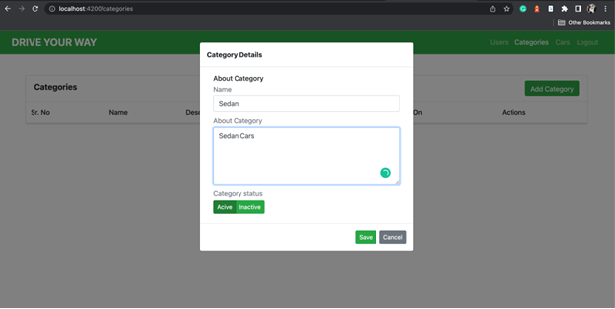
Admin Functionalities: Manage Categories

Slide 12
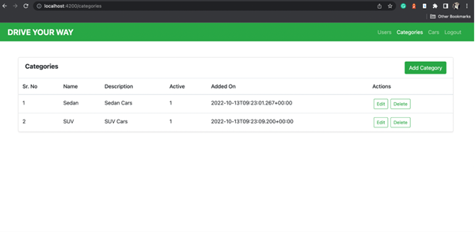
Admin Functionalities: View Car Categories

Slide 13
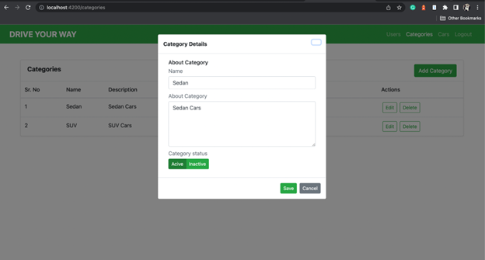
Admin Functionalities: Edit Car Category

Slide 14
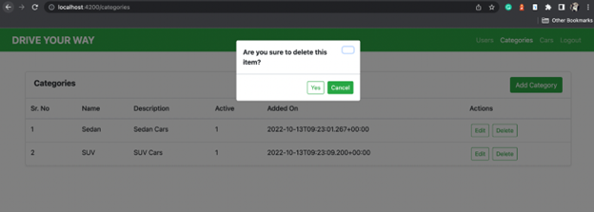
Admin Functionalities: Delete Car Category

Slide 15
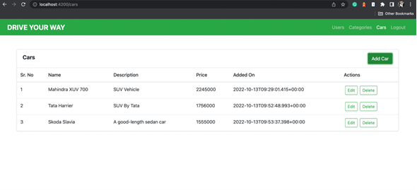
Manage Cars: View Cars

Slide 16
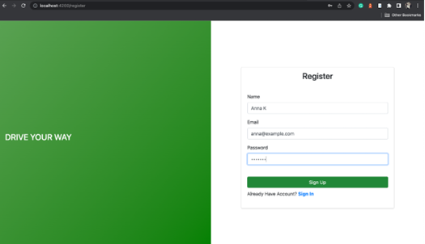
End-User Functionalities: Registration Page

Slide 17
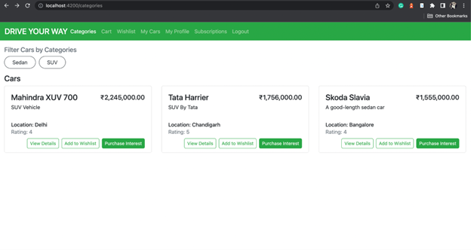
Car Listing Screenshot

Slide 18
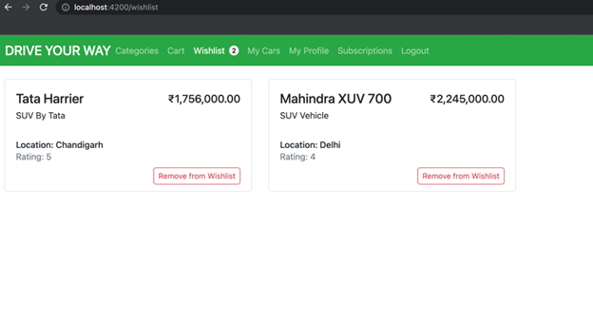
Wishlist Screenshot

Slide 19
Subscription Screenshot

